Slide 1
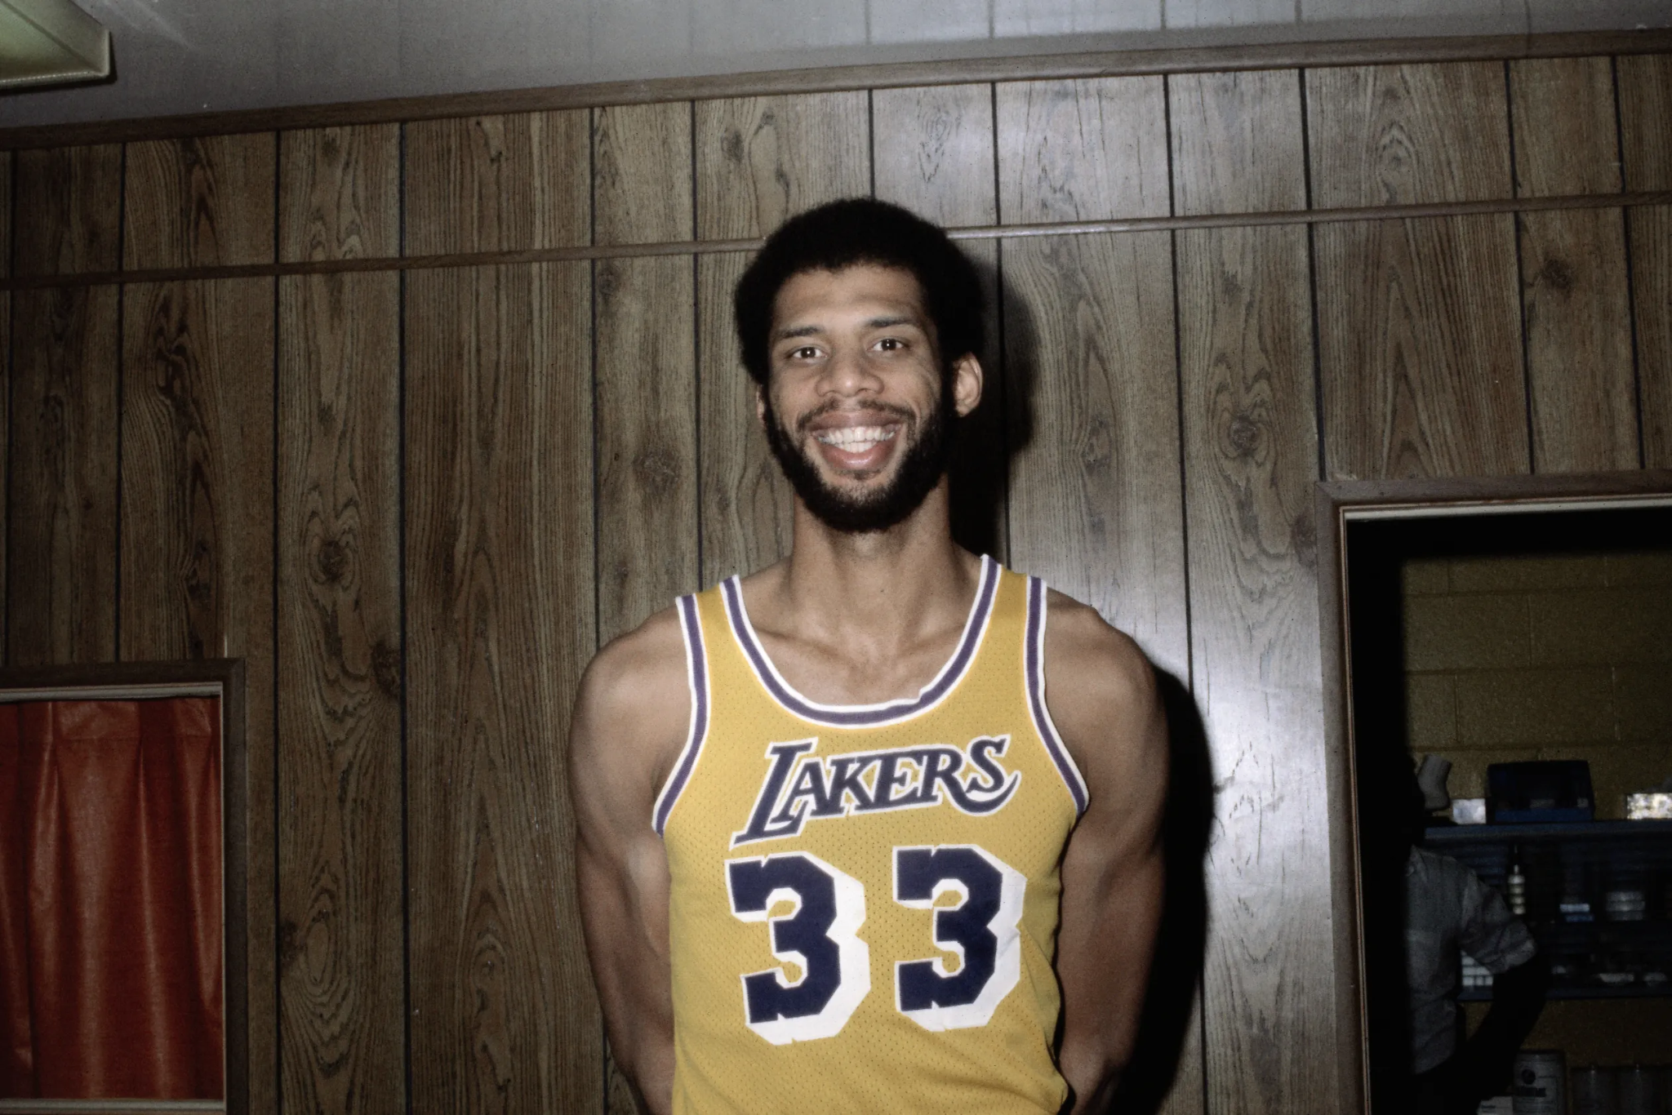
Notes:
Kareem Abdul-Jabbar

Slide 2
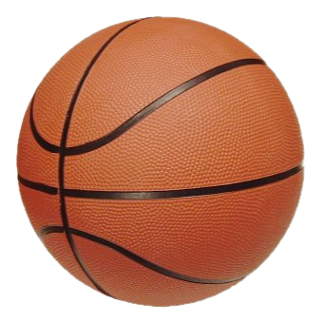
Notes:
basketball

Slide 3
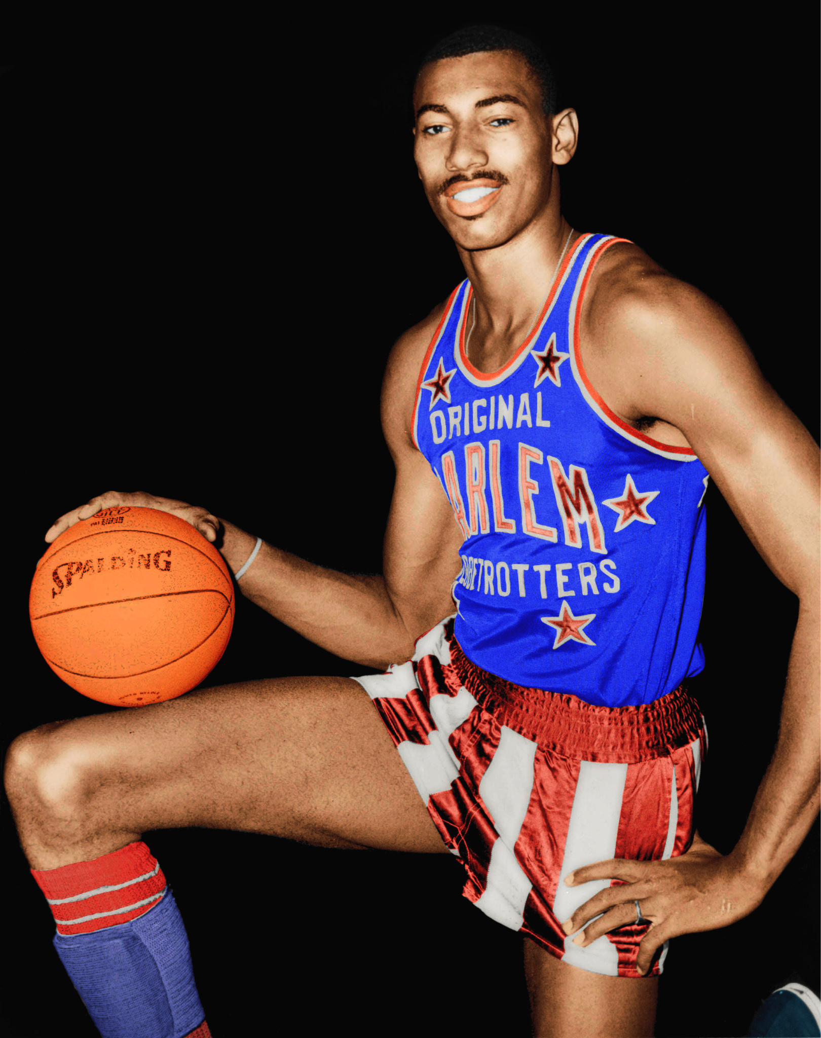
Notes:
Wilt Chamerlain

Slide 4
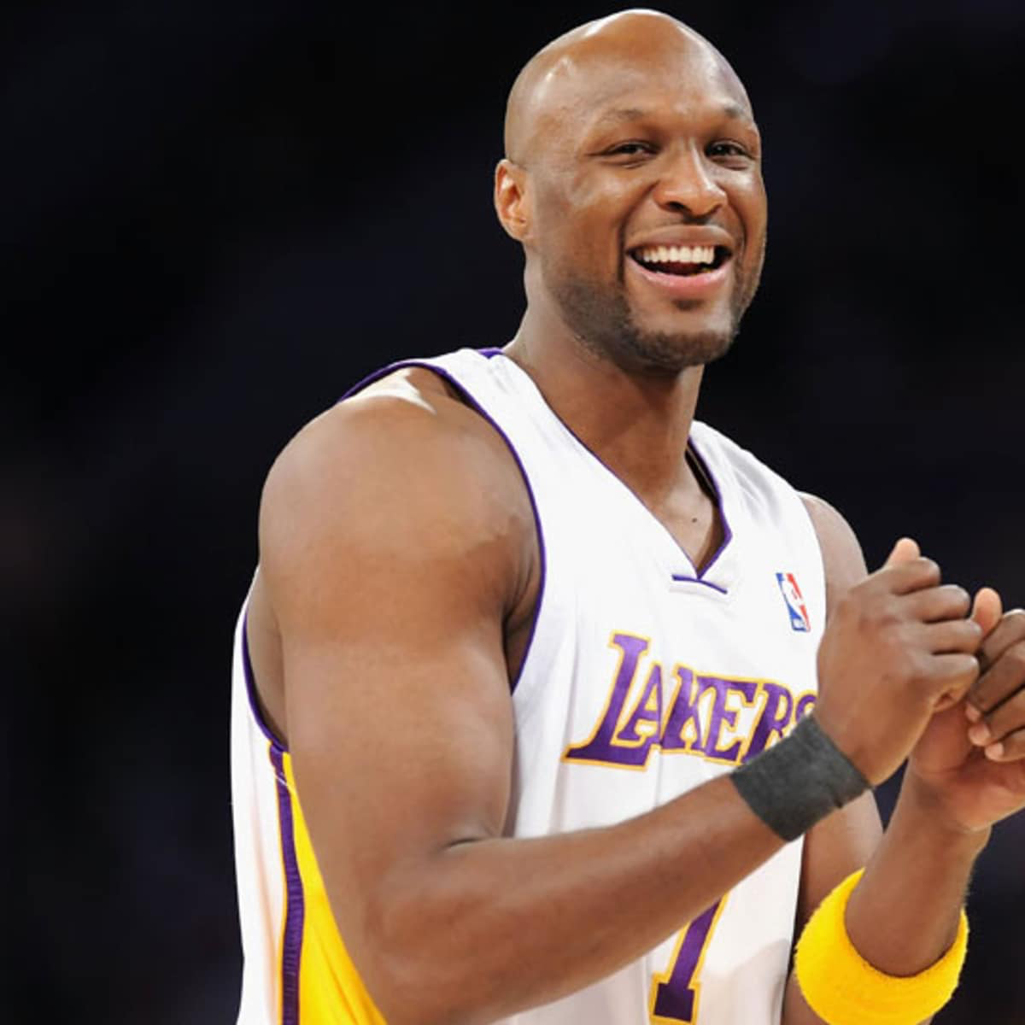
Notes:
Lamar Odom

Slide 5
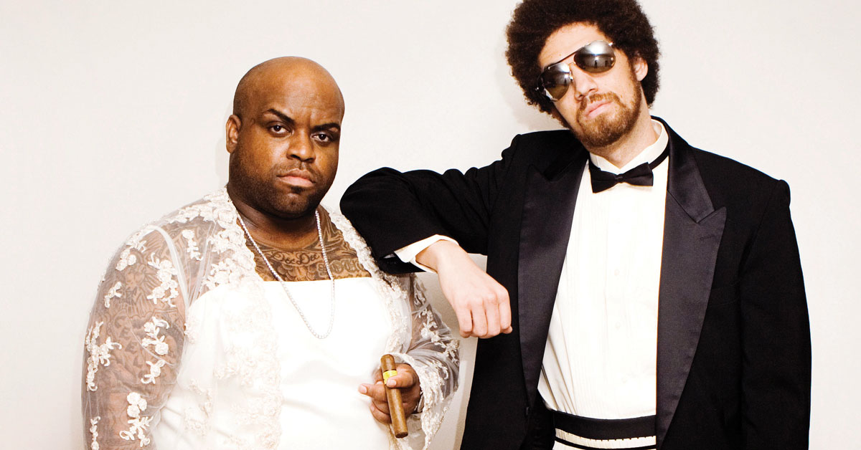
Notes:
Gnarls Barkley

Slide 6
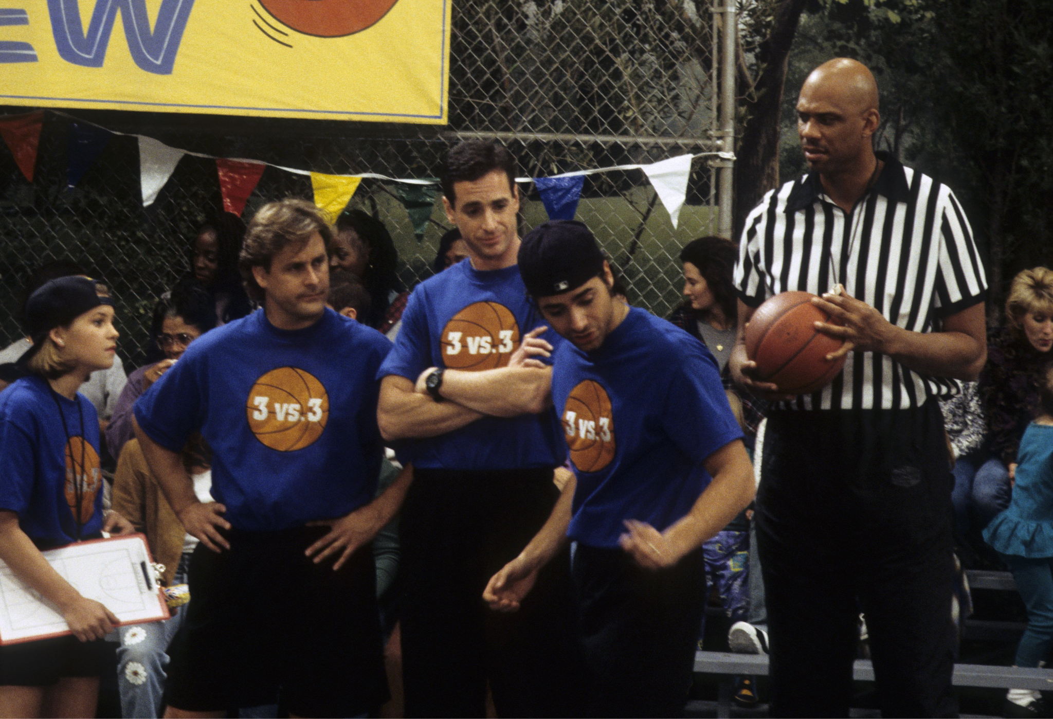
Notes:
Full House

Slide 7
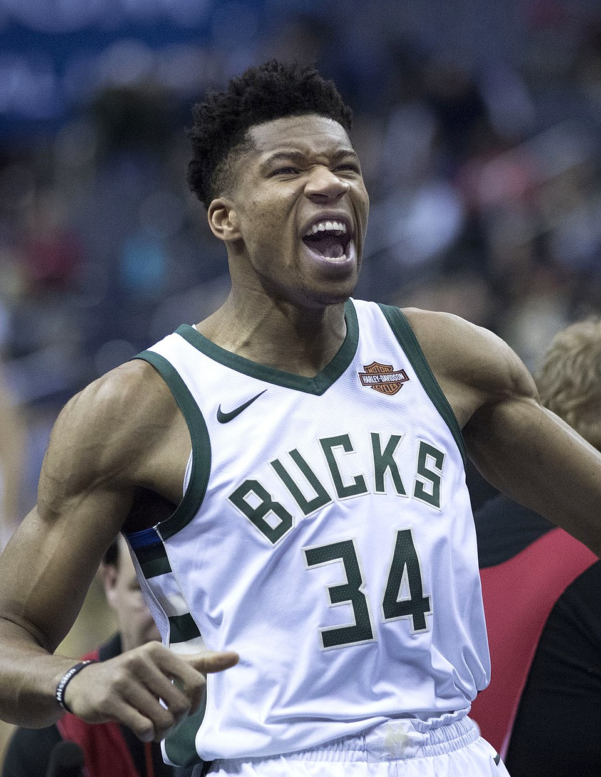
Notes:
Giannis Antetokounmpo

Slide 8
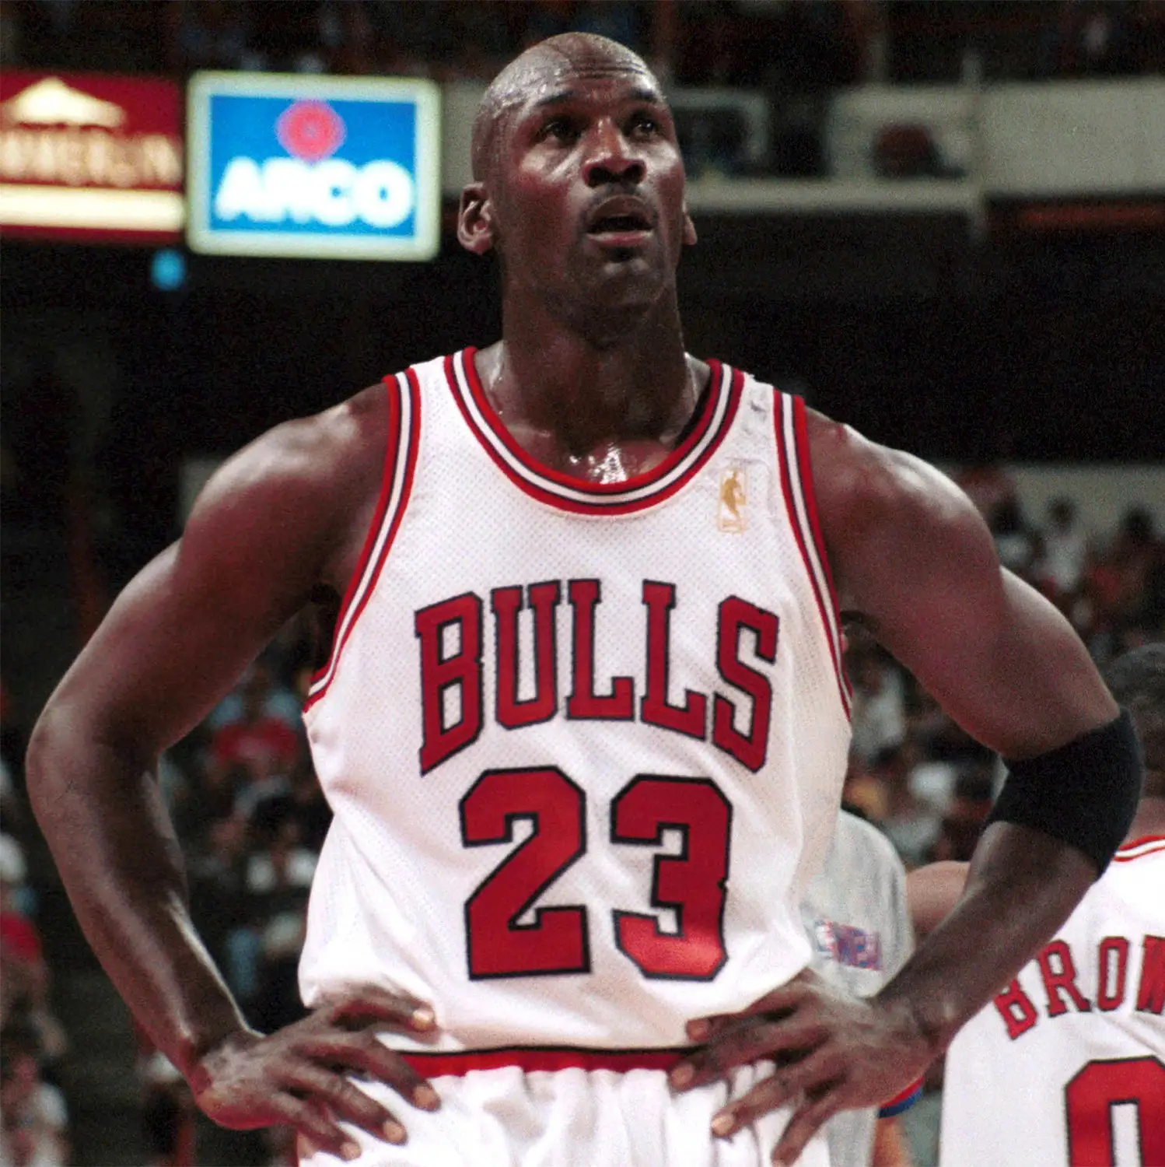
Notes:
Michael Jordan

Slide 9
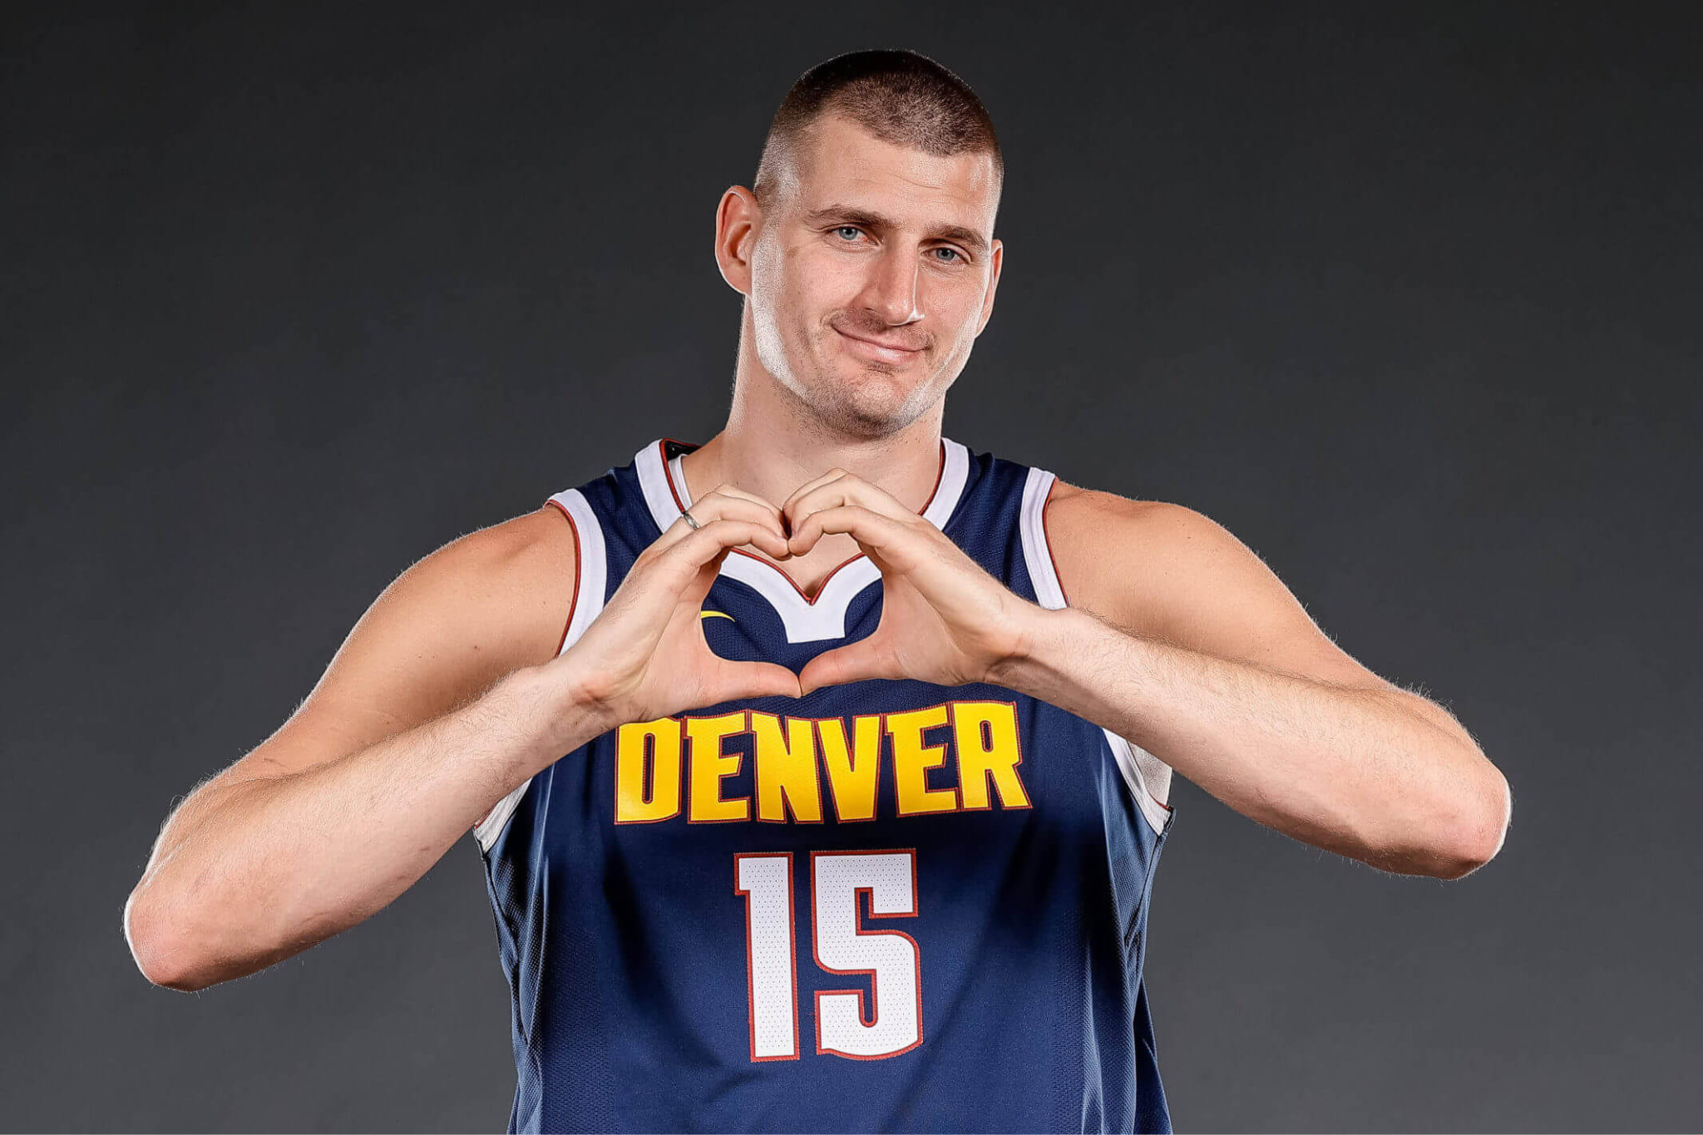
Notes:
Nikola Jokic

Slide 10
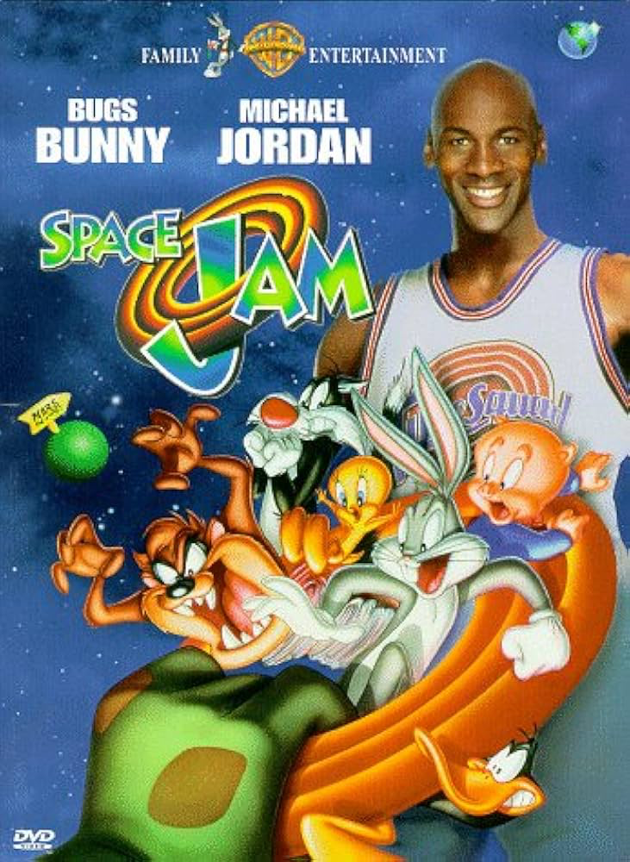
Notes:
Space Jam

Slide 11
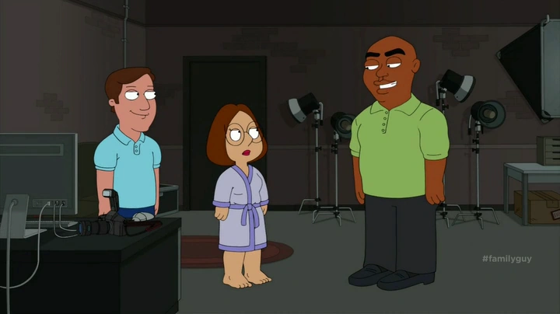
Notes:
Family guy

Slide 12
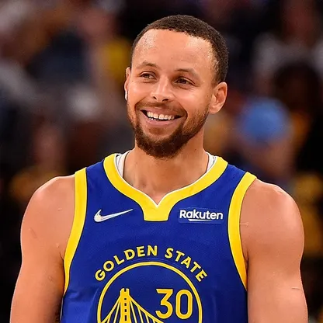
Notes:
Steph Curry

Slide 13
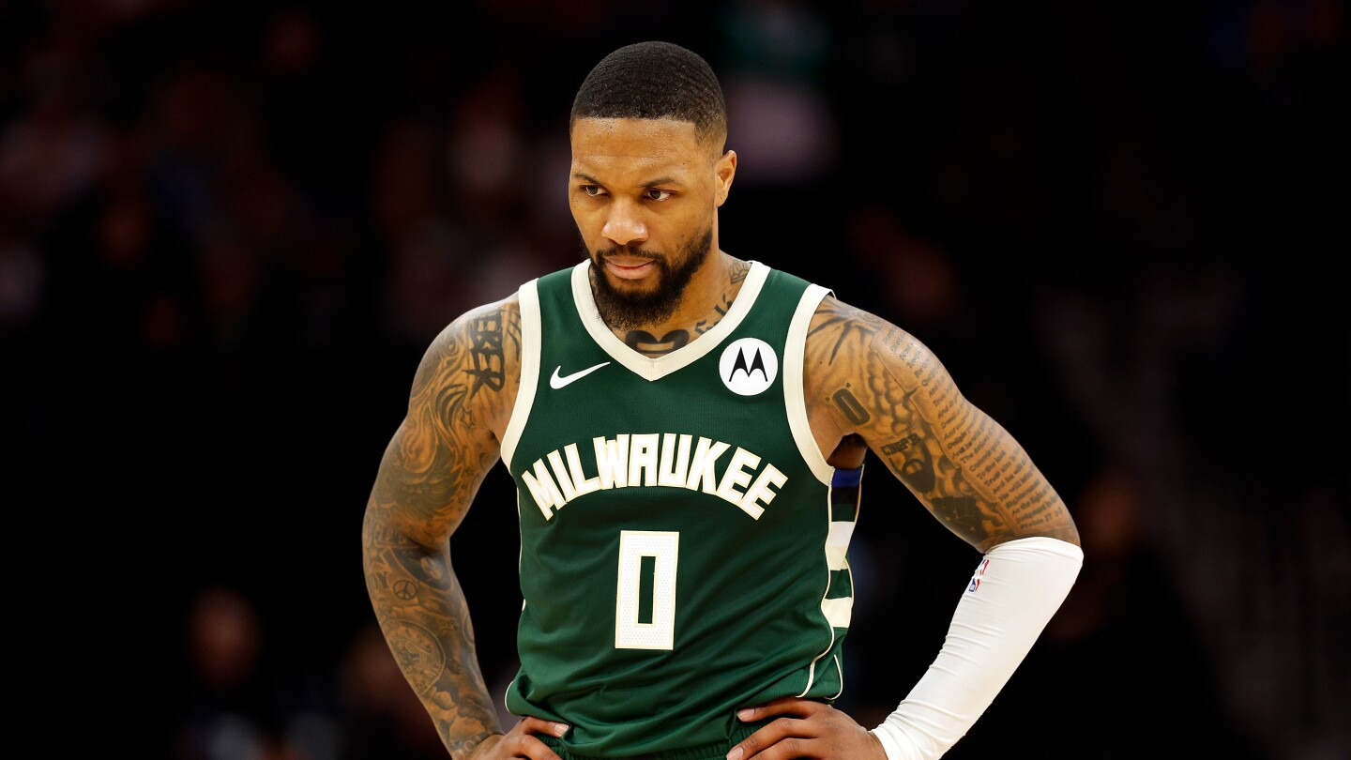
Notes:
Damian Lillard

Slide 14
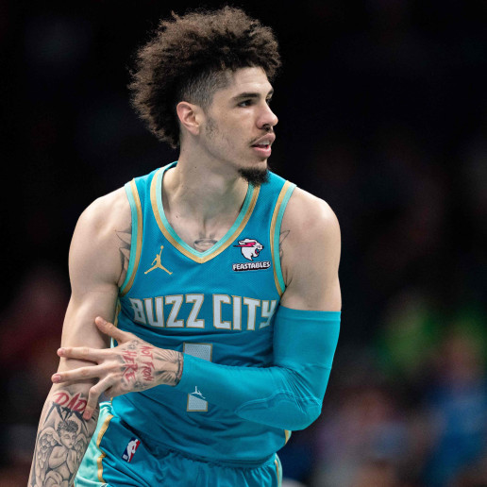
Notes:
Lamelo Ball

Slide 15
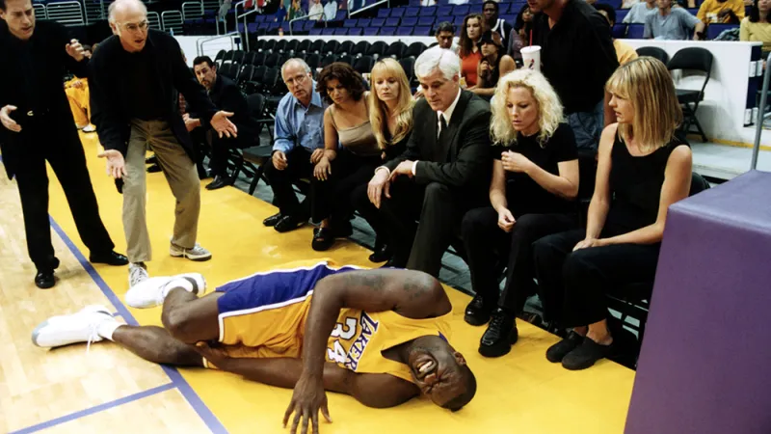
Notes:
Curb your enthusiasm

Slide 16
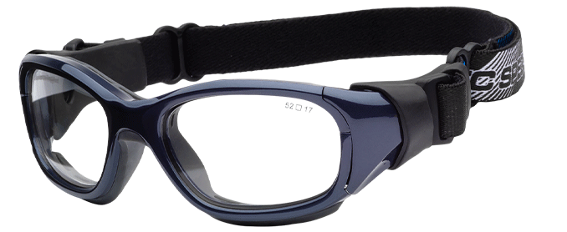
Notes:
Basketball goggles

Slide 17
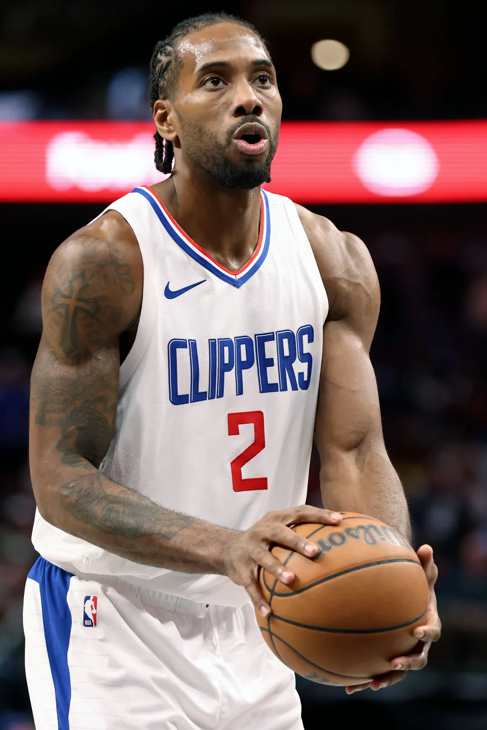
Notes:
Kawhi Leonard

Slide 18
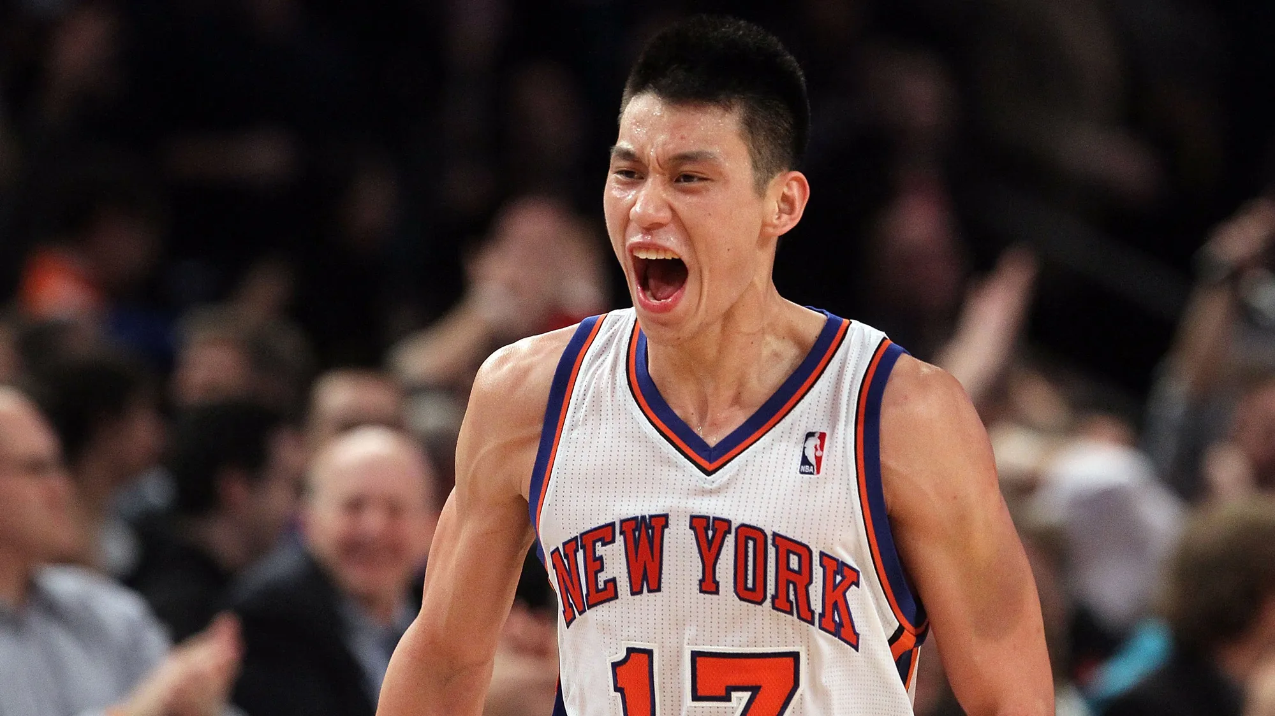
Notes:
Jeremy Lin

Slide 19
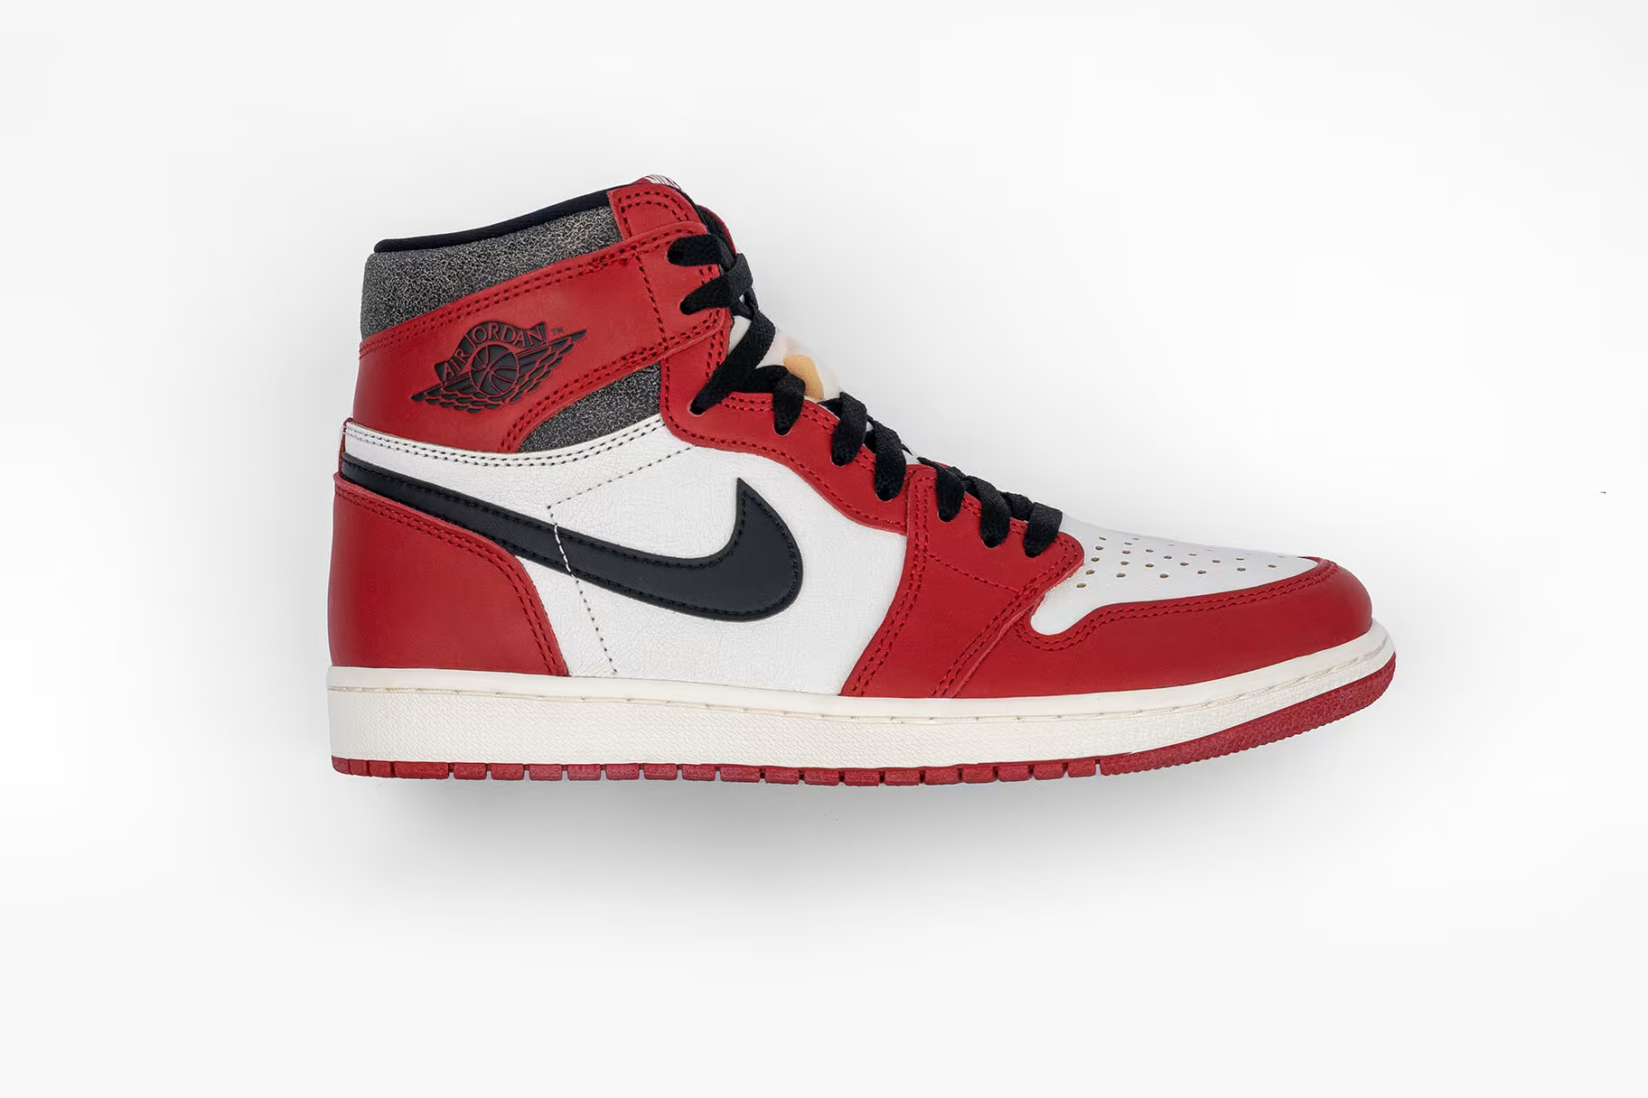
Notes:
Air Jordan 1

Slide 20
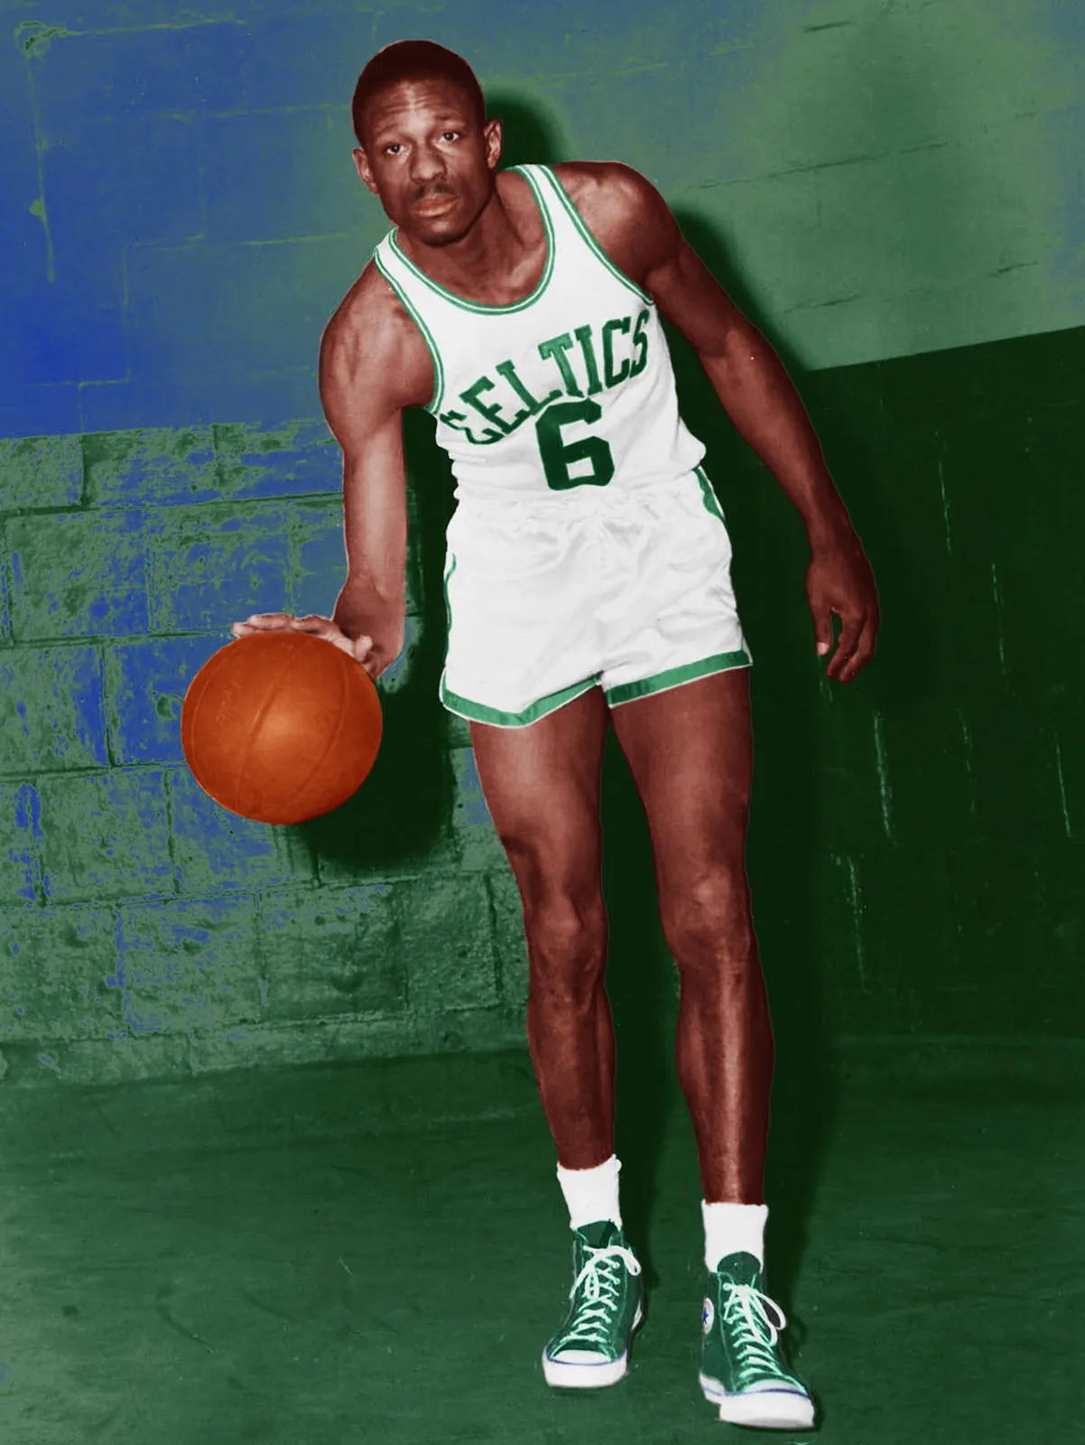
Notes:
Bull Russell

Slide 21
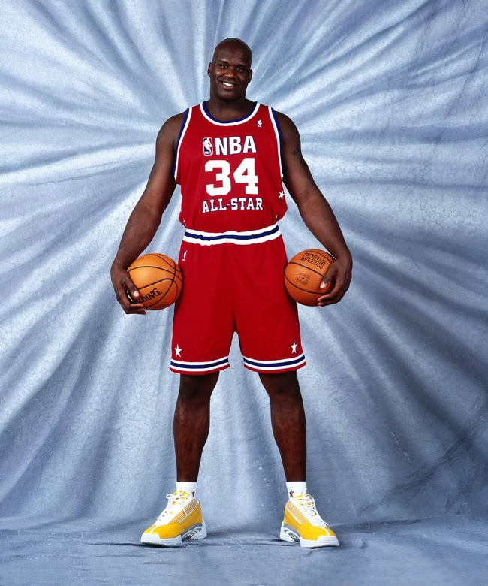
Notes:
Shaq(uille O’Neal)

Slide 22
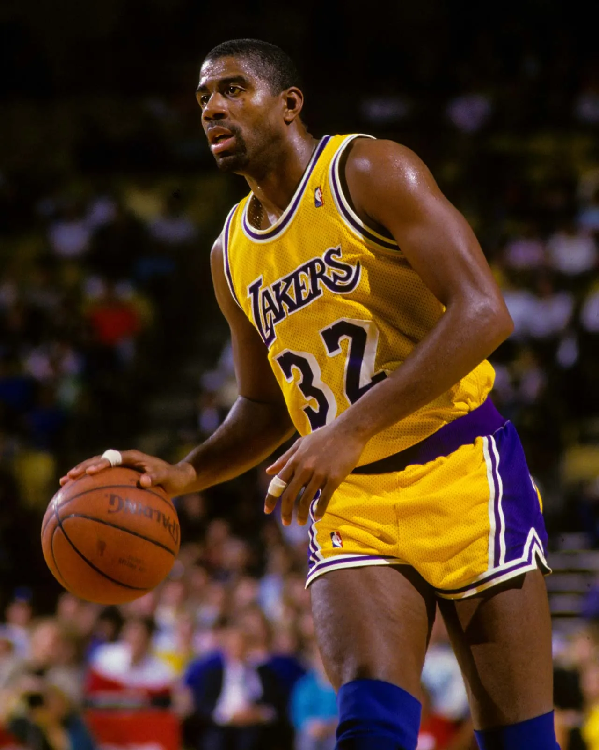
Notes:
Magic Johnson

Slide 23
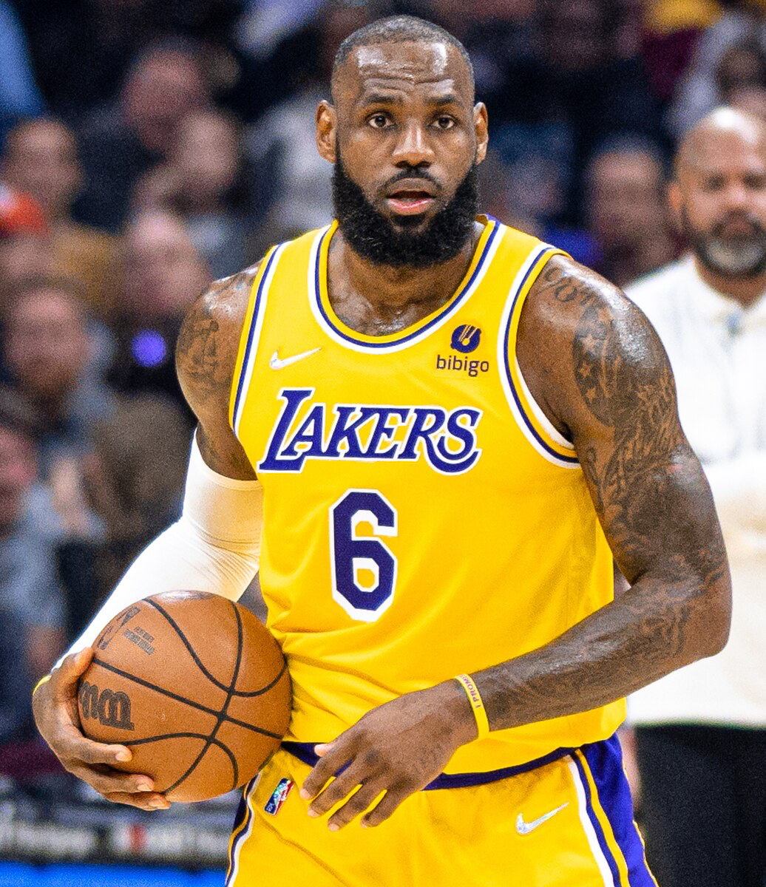
Notes:
LeBron James

Slide 24
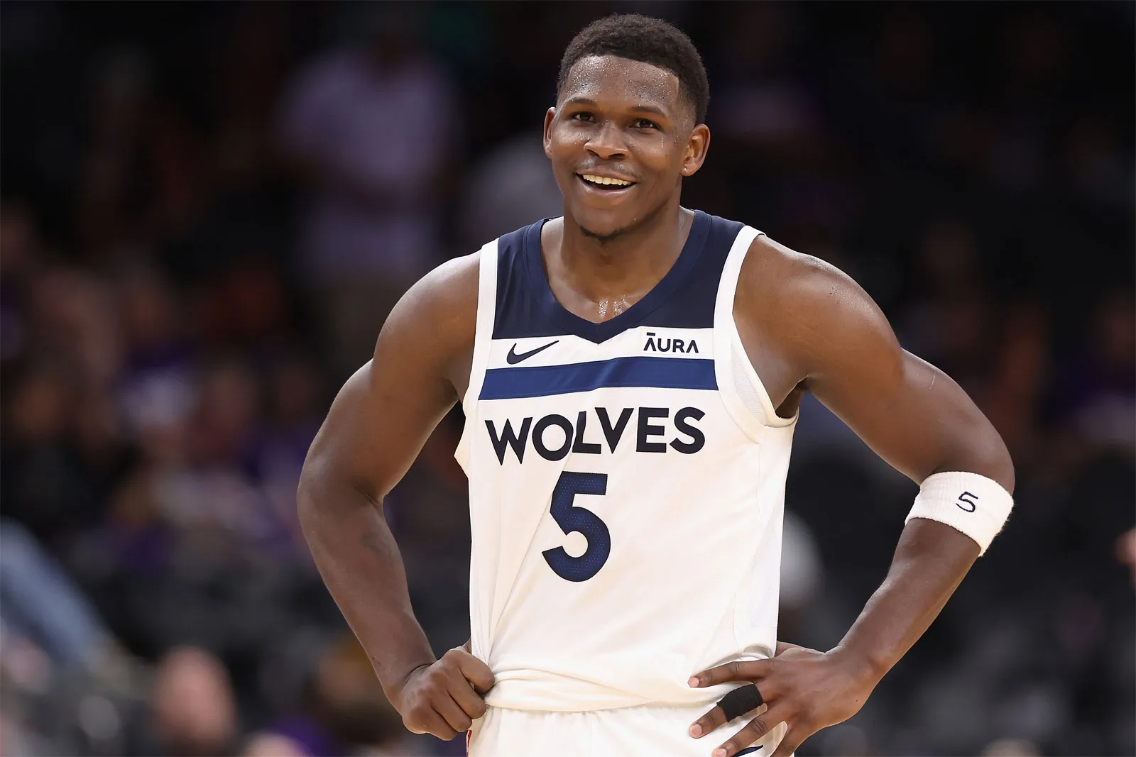
Notes:
Anthony Edwards

Slide 25
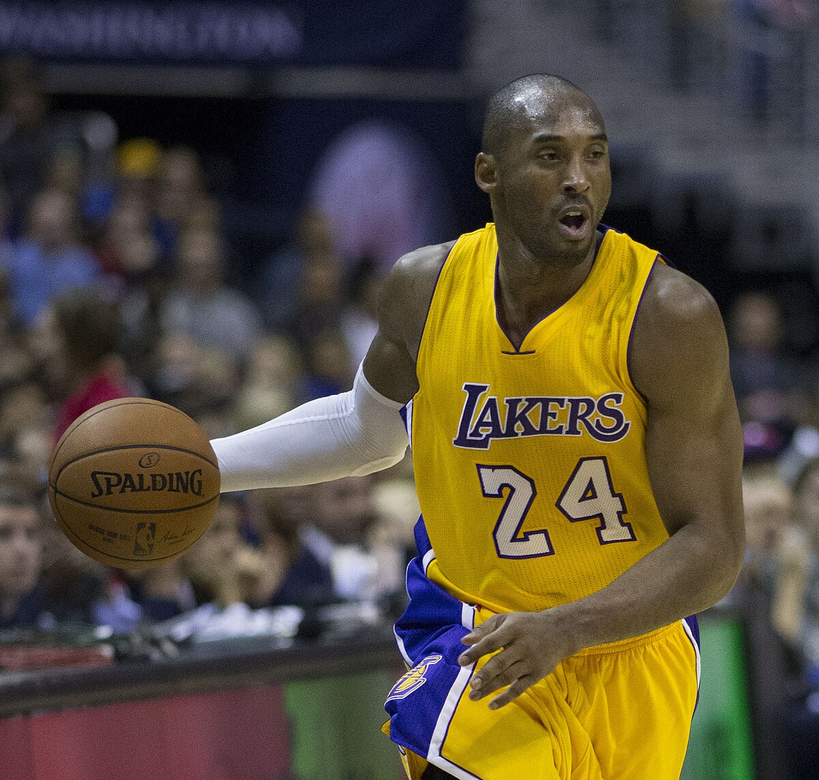
Notes:
Kobe Bryant

Slide 26
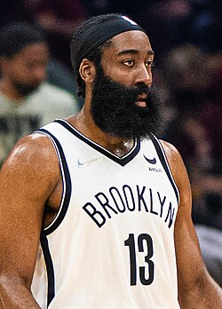
Notes:
James Harden

Slide 27
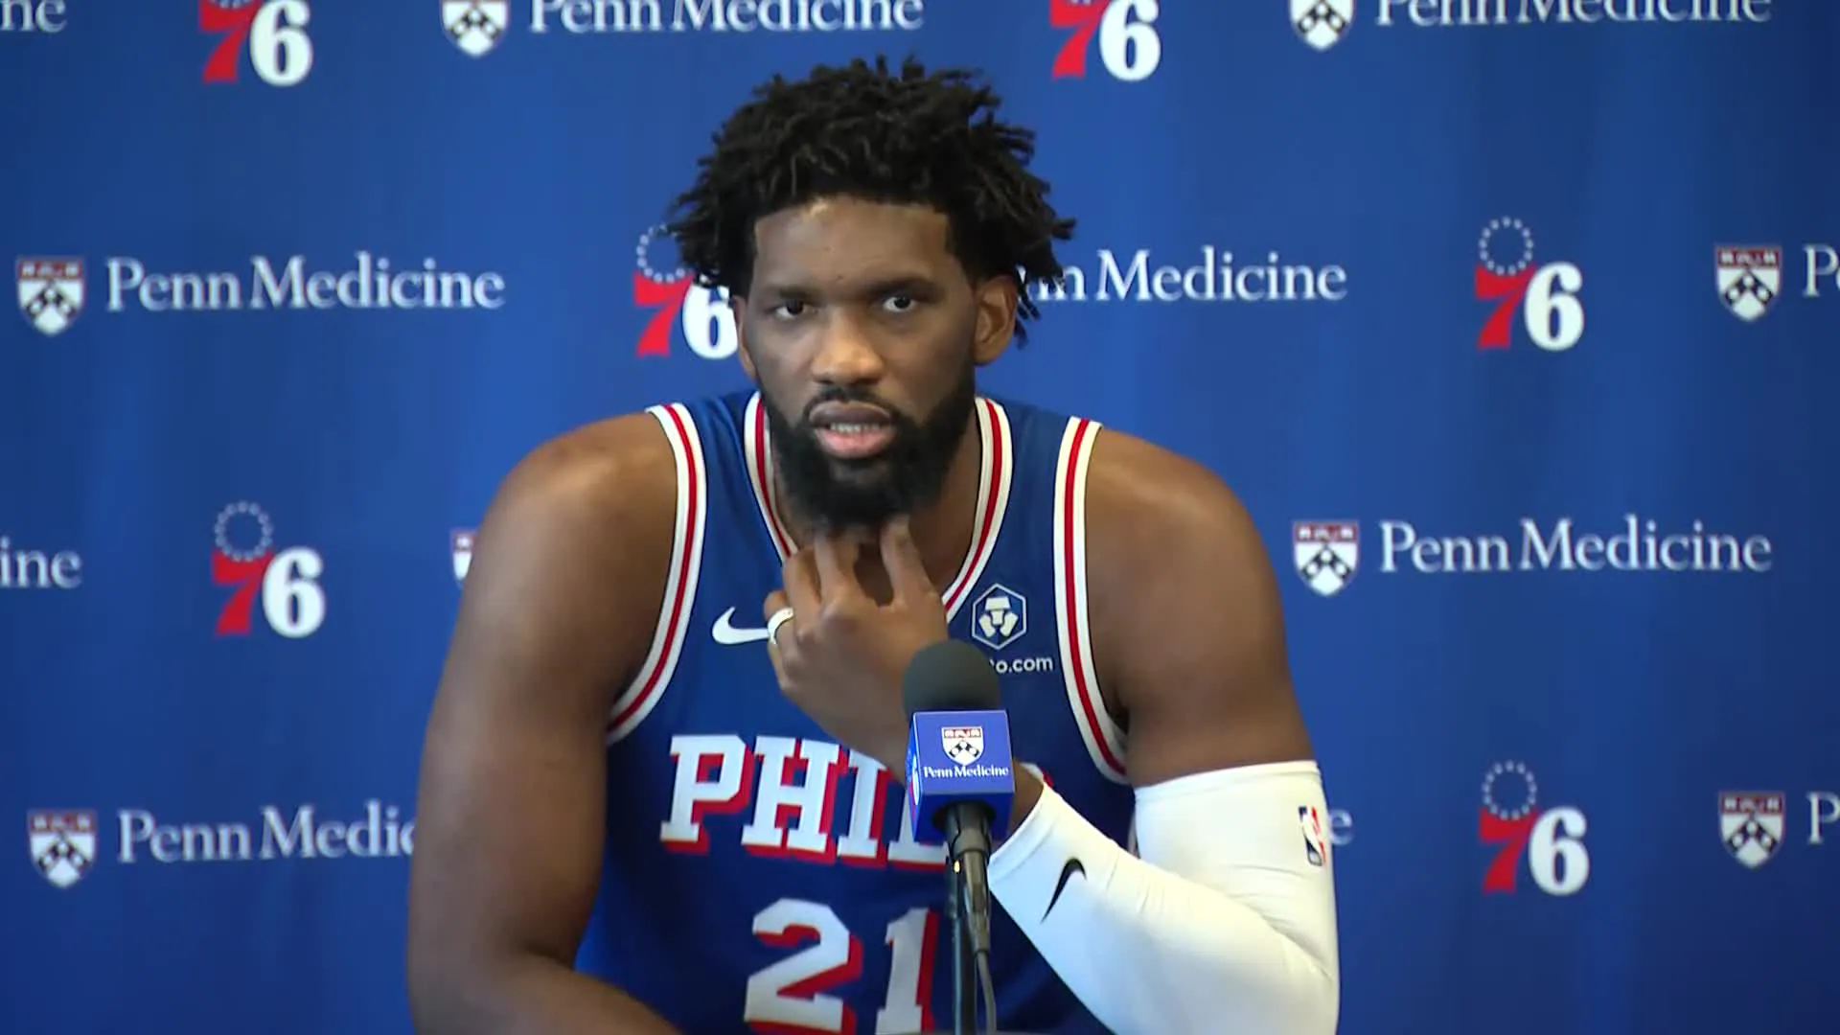
Notes:
Joel Embiid

Slide 28
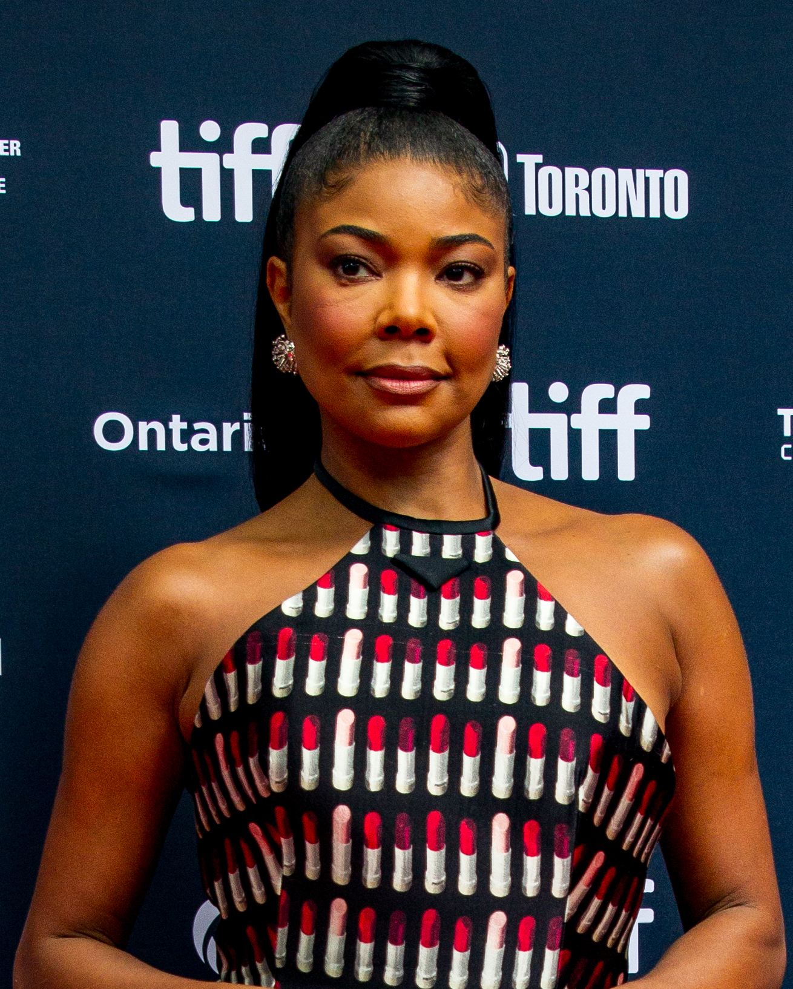
Notes:
Gabrielle Union

Slide 29
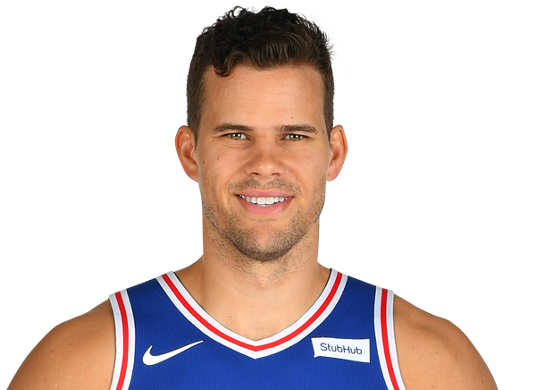
Notes:
Kris Humphries

Slide 30
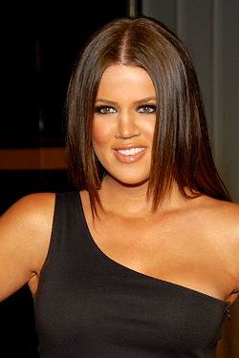
Notes:
Khloe Kardashian

Slide 31
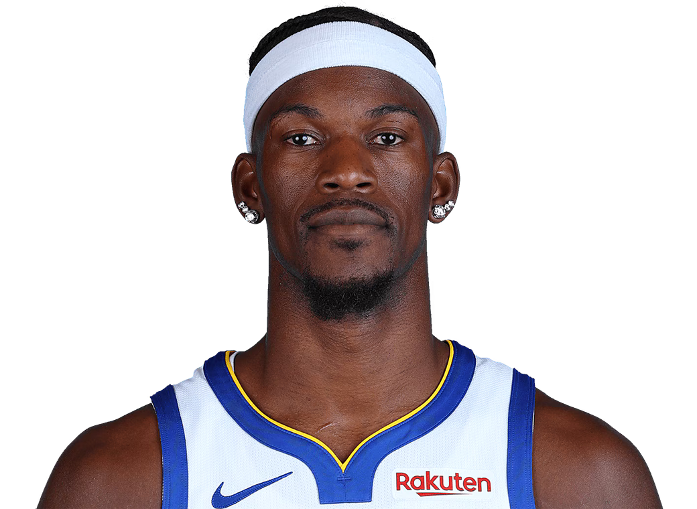
Notes:
Jimmy Butler

Slide 32
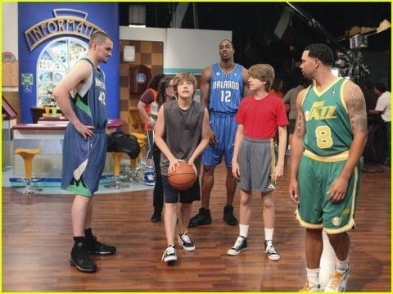
Notes:
The Suite Life on Deck

Slide 33
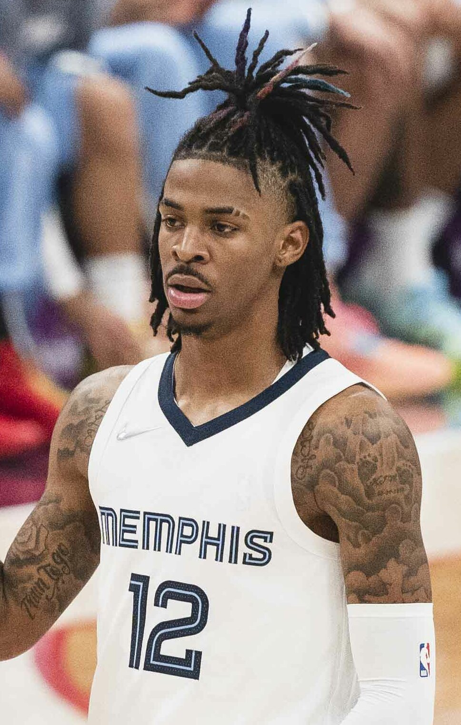
Notes:
Ja Morant

Slide 34
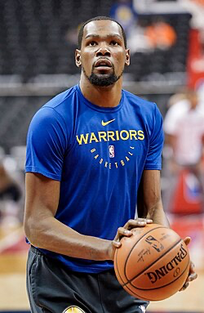
Notes:
Kevin Durant

Slide 35
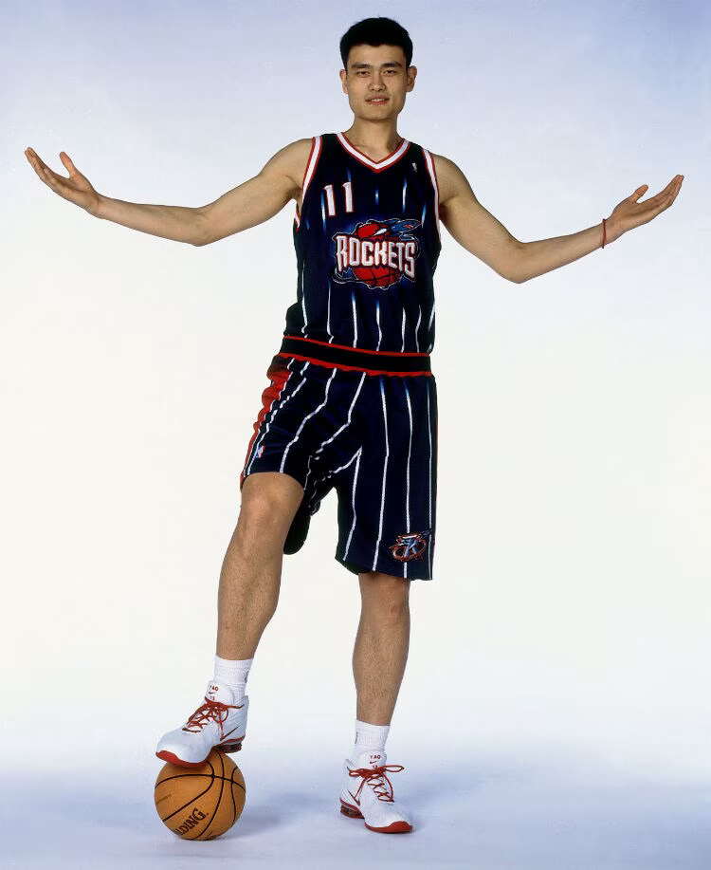
Notes:
Yao Ming

Slide 36
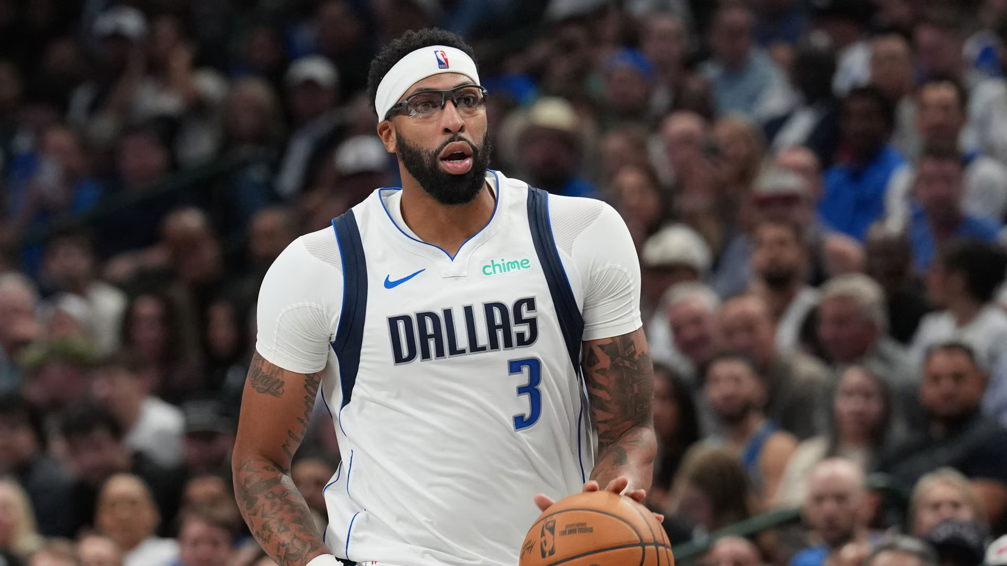
Notes:
Anthony Davis

Slide 37
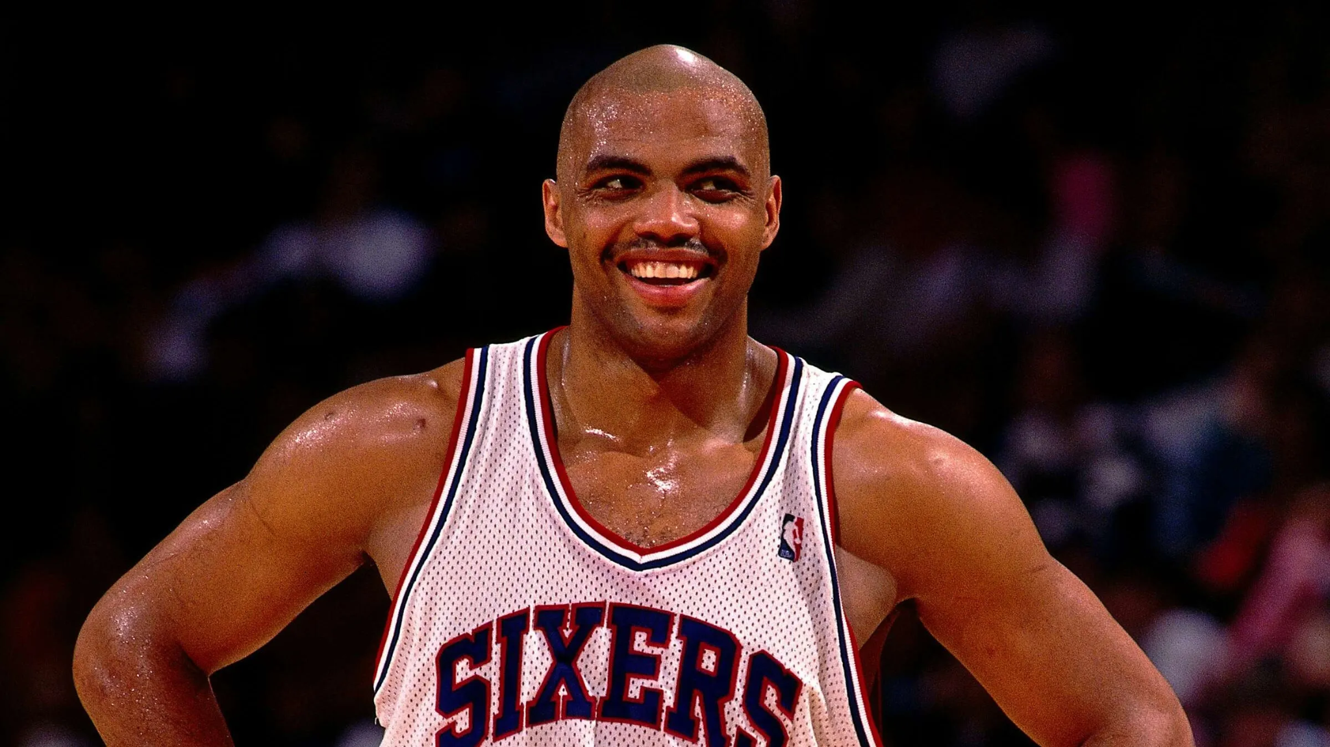
Notes:
Charles Barkley

Slide 38
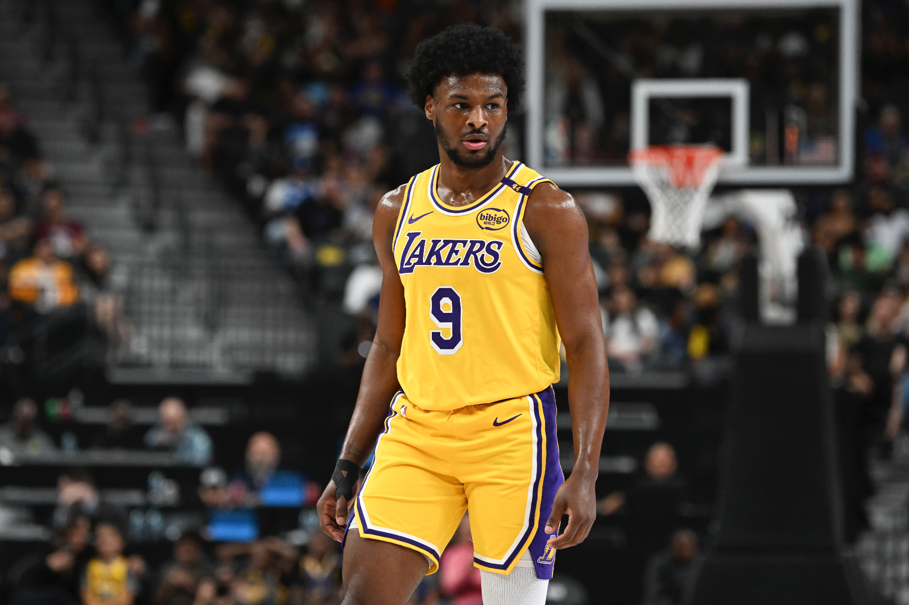
Notes:
Bronny James

Slide 39
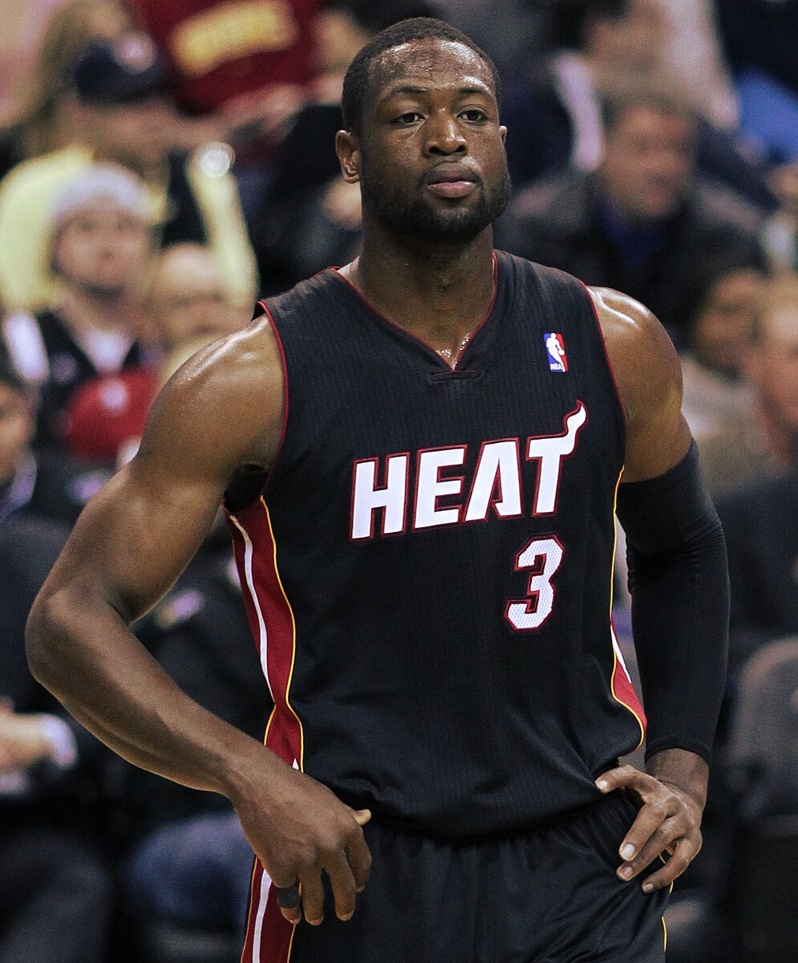
Notes:
Dwayne Wade

Slide 40
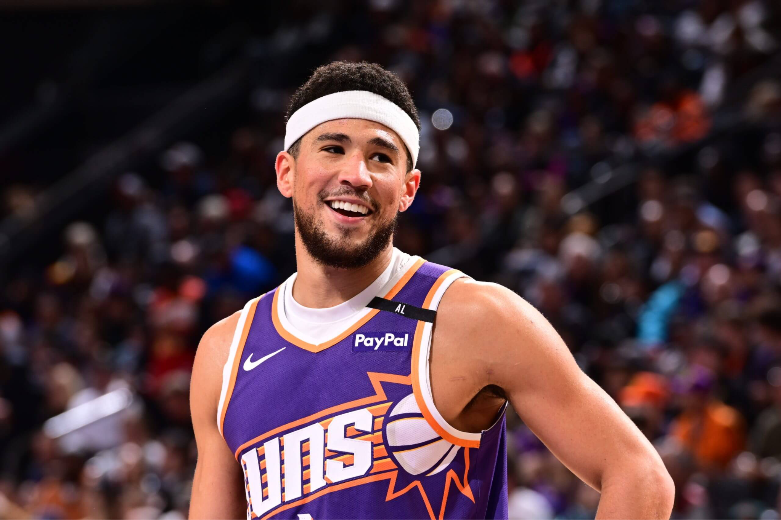
Notes:
Devin Booker

Slide 41
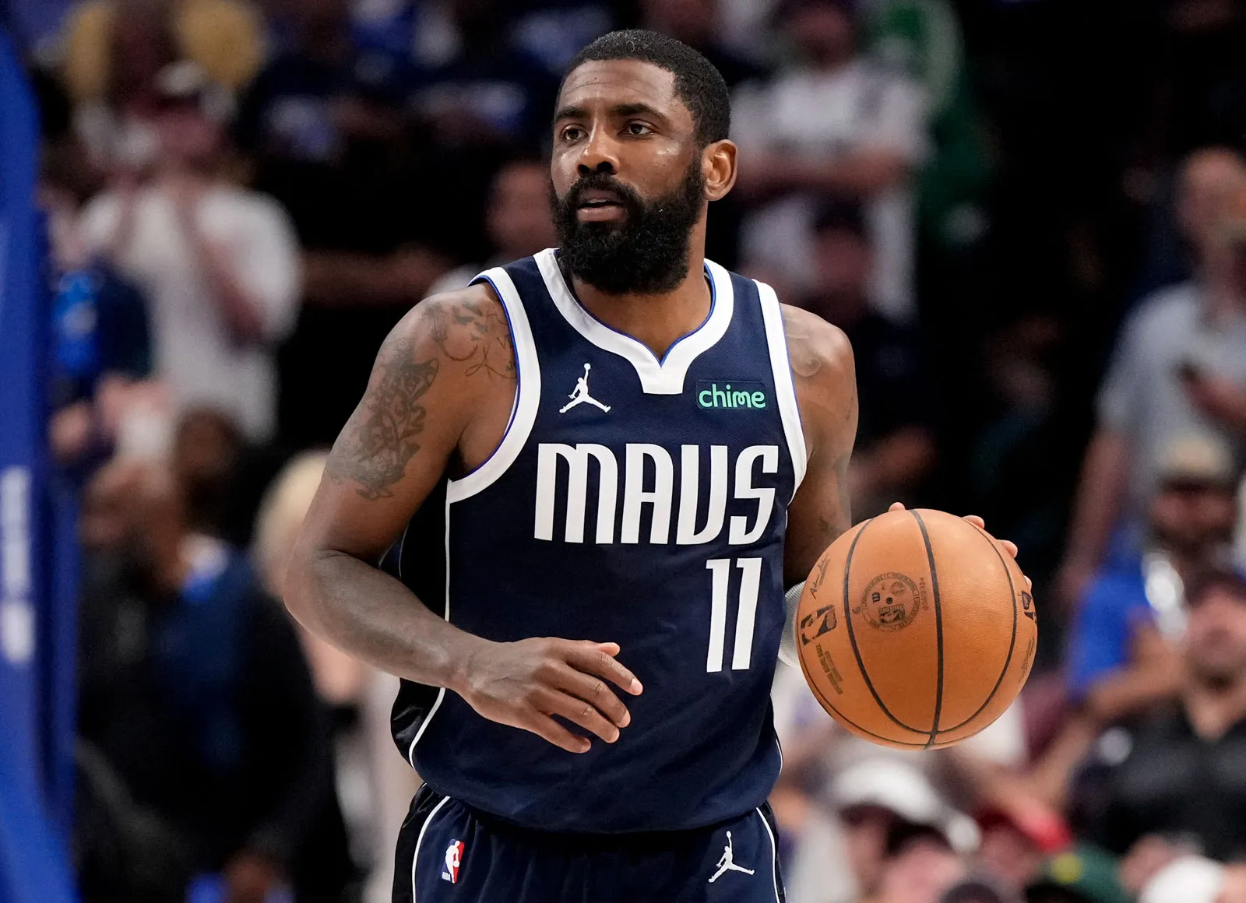
Notes:
Kyrie Irving

Slide 42
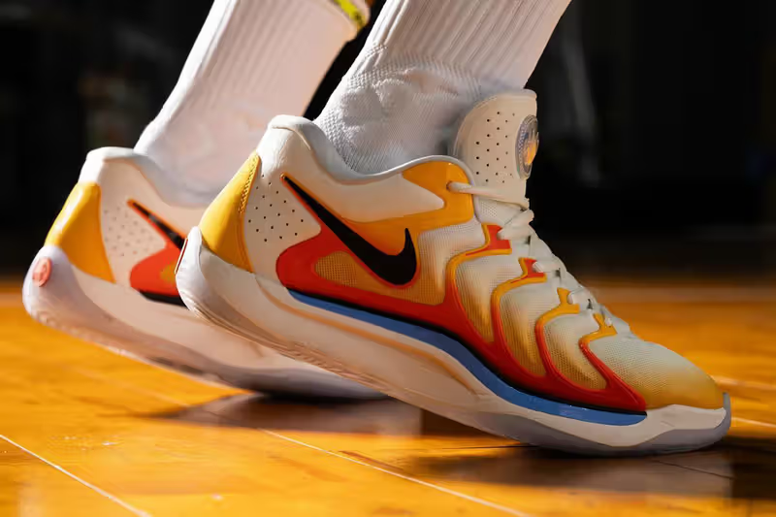
Notes:
Nike KD

Slide 43

Notes:
Holey Moley

Slide 44
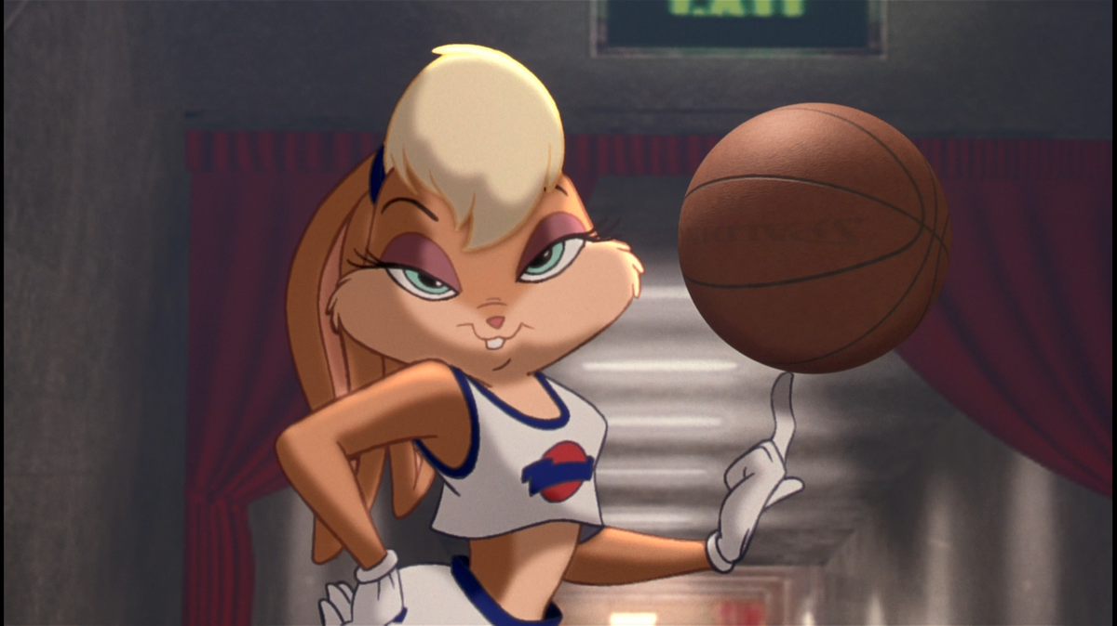
Notes:
Lola Bunny

Slide 45
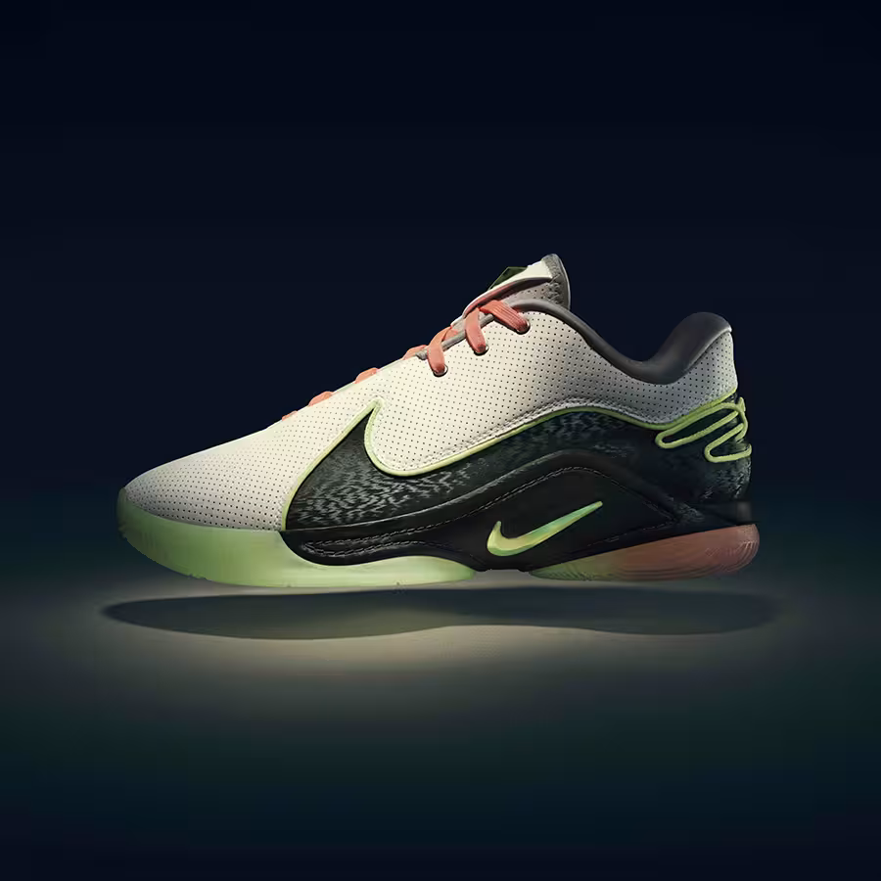
Notes:
Nike LeBron

Slide 46
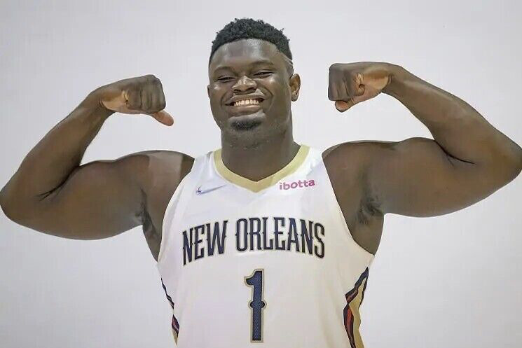
Notes:
Zion Williamsin

Slide 47
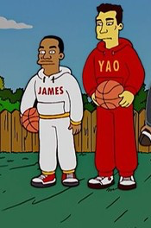
Notes:
The Simpsons

Slide 48
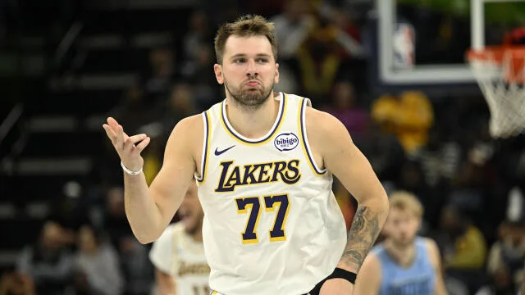
Notes:
Luka Doncic

Slide 49
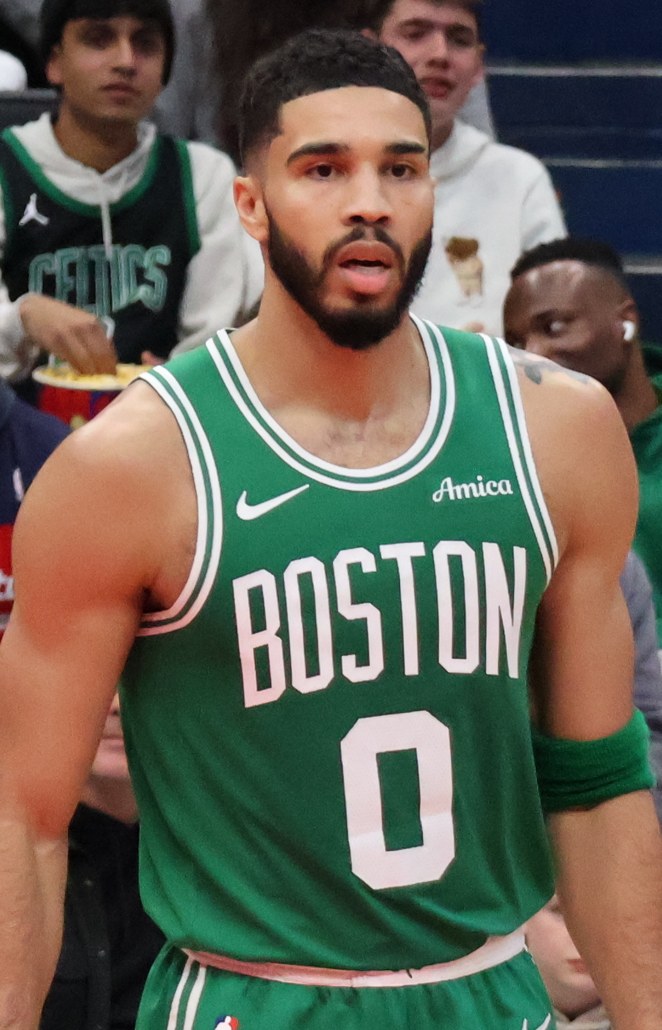
Notes:
Jayson Tatum

Slide 50
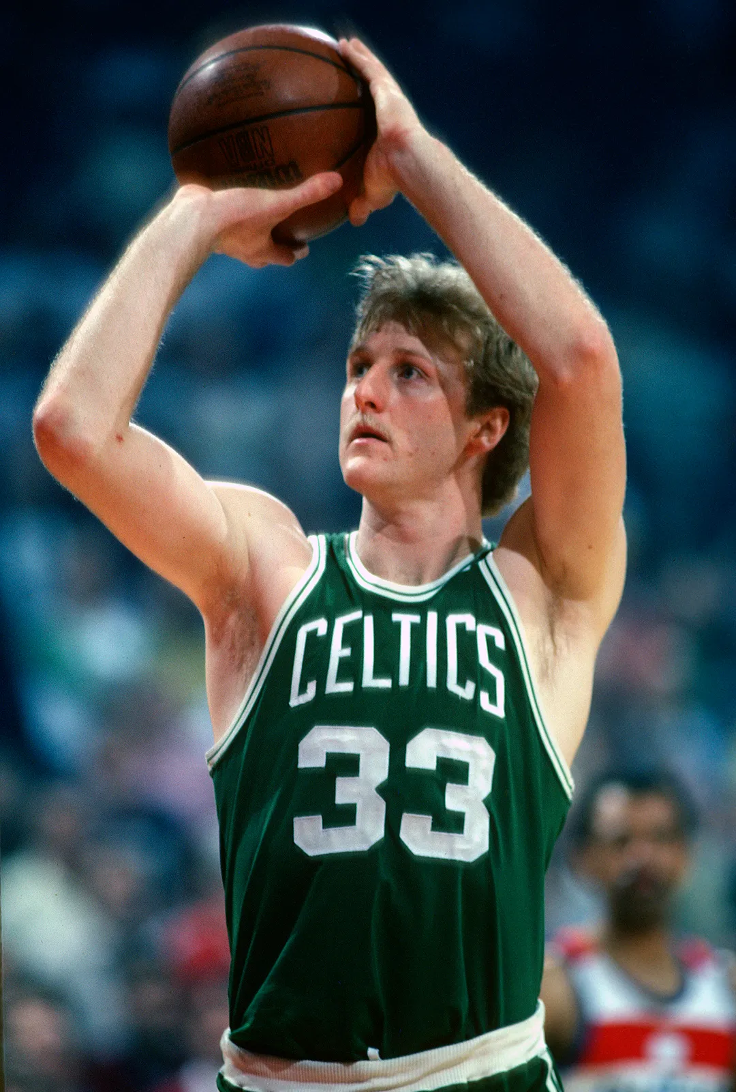
Notes:
Larry Bird

